Slide 1
Linux Power Tools
for Efficient Development
by Hussain Sultan
citiBank
<<<<<<< HEAD
// This is the main branch version
=======
// This is the feature branch version
>>>>>>> feature

Slide 2


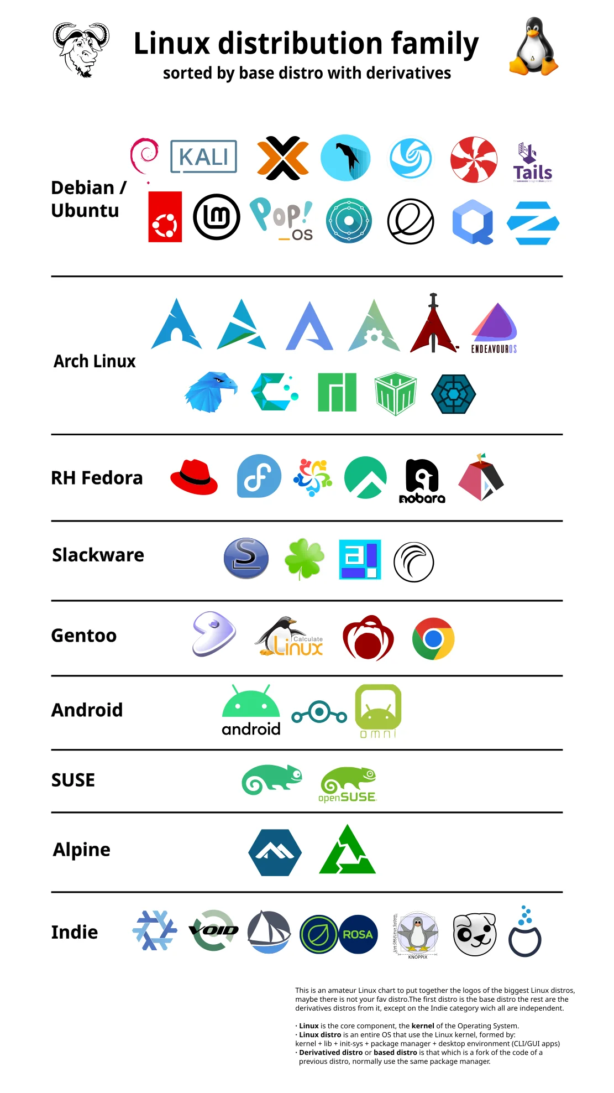
Introduction
What is Linux?
Its an open-source operating system kernel created by Linus Torvalds in 1991. Developed collaboratively by a global community.
Why Linux tools?
Open-source Nature
Stability and Security
Flexibility and Customizability
Compatibility and Integration
Community Support

Slide 3
01
VCS
for Efficient Development
<<<<<<< HEAD
// This is the main branch version
=======
// This is the feature branch version
>>>>>>> feature

Slide 4
VCS
Definition
A VCS (Version Control System) is a tool that helps track changes to files over time, allowing multiple users to collaborate and manage version history efficiently.
<<<<<<< HEAD
// This is the main branch version
=======
// This is the feature branch version
>>>>>>> feature

Slide 5
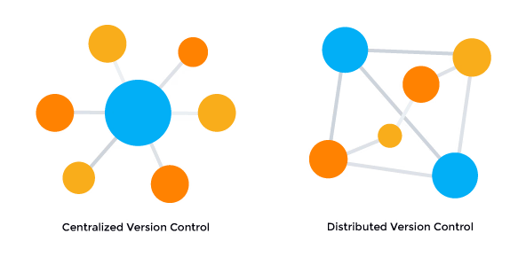
Distributed VCS
Types of VCS
01
02
Centralized VCS
Use a single central server to manage versioned files, requiring network access for collaboration.
Allow each user to have a complete copy of the repository, enabling offline work and independent version management.

Slide 6

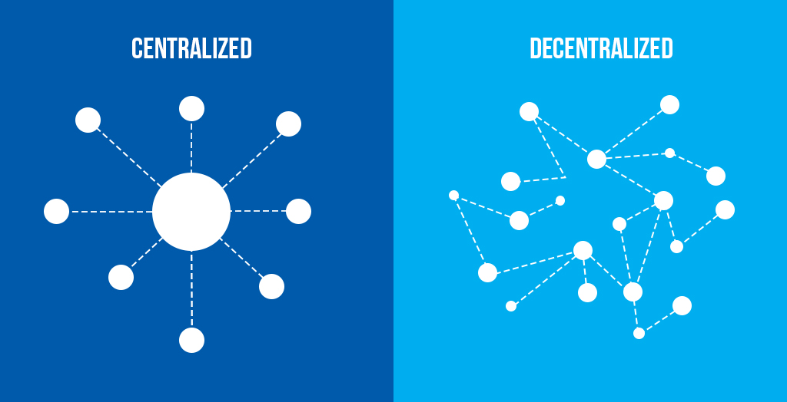


Centralized VCS
Subversion (SVN)
Team Foundation Version Control (TFVC)
Perforce (Helix Core)
Used In: Software development, enterprise projects.
Key Features: Atomic commits, branching/tagging support.
Used In: Microsoft-centric environments, Azure DevOps.
Key Features: Fine-grained access control, strong integration with Visual Studio.
Used In: Game development, large enterprises.
Key Features: High performance, strong handling of large files.

Slide 7



Distributed VCS
Git
Mercurial
Bazaar
Used In: Open-source projects, software development.
Key Features: Local repos, powerful branching/merging, community support.
Used In: Python projects, enterprise apps.
Key Features: Simple commands, efficient for large projects.
Used In: Ubuntu development, flexible workflows.
Key Features: Usability, supports centralized/decentralized models.

Slide 8

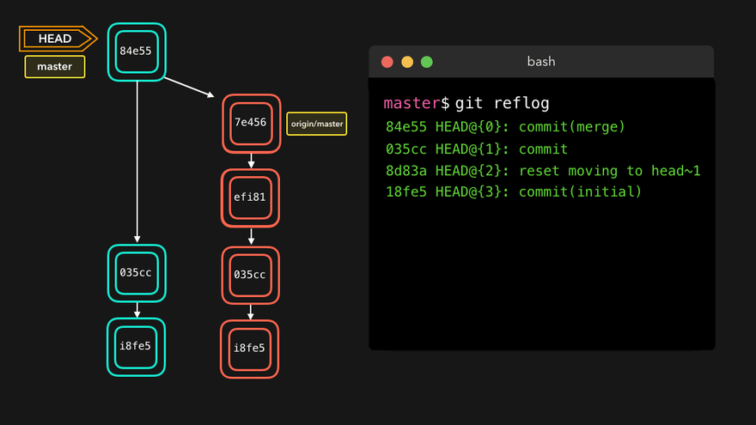
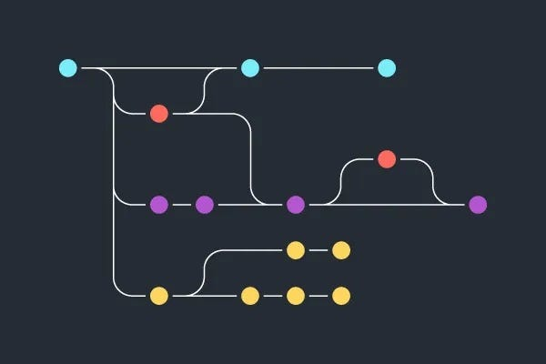
Git
Distributed VCS - Git
What is Git?
Git is a distributed version control system (vcs), created by Linus Torvalds in 2005, that allows multiple developers to track changes in files, collaborate on projects, and efficiently manage code history.
Why Git?
Distributed Architecture
Collaboration: Branching and Merging
Version History
Efficiency
Compatibility and Integration

Slide 9
Git config
Distributed VCS - Git
$ git config ––global user.name “[name]”
$ git config ––global user.email “[email]”
$ git config ––global color.ui auto
$ git config ––global core.editor vim

Slide 10
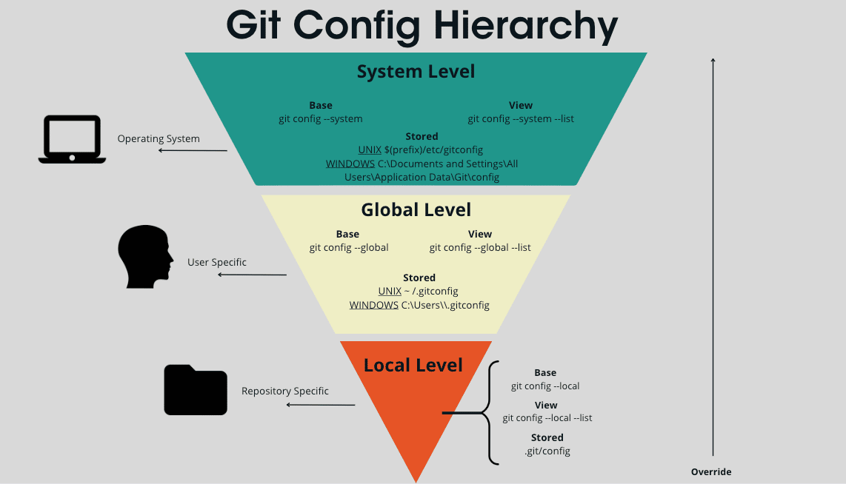
Git config types
Distributed VCS - Git
$ git config ––system edit
$ git config ––global edit
$ git config ––local edit

Slide 11
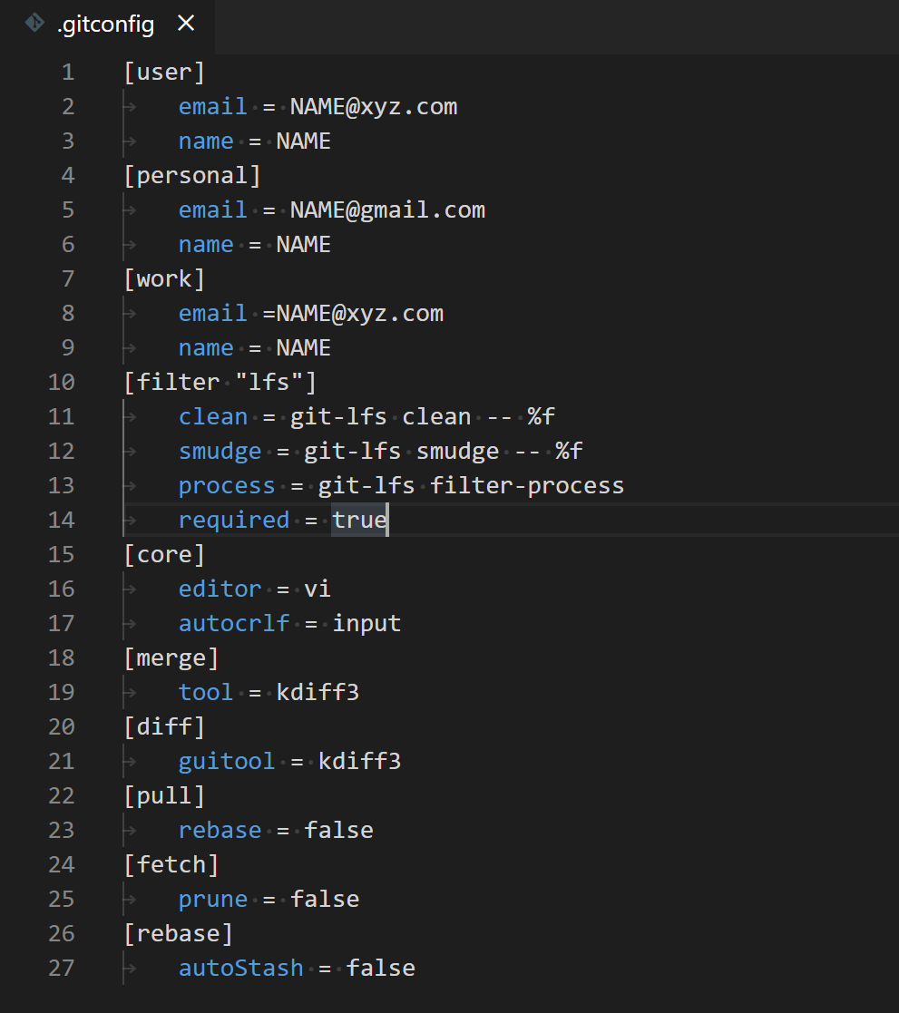
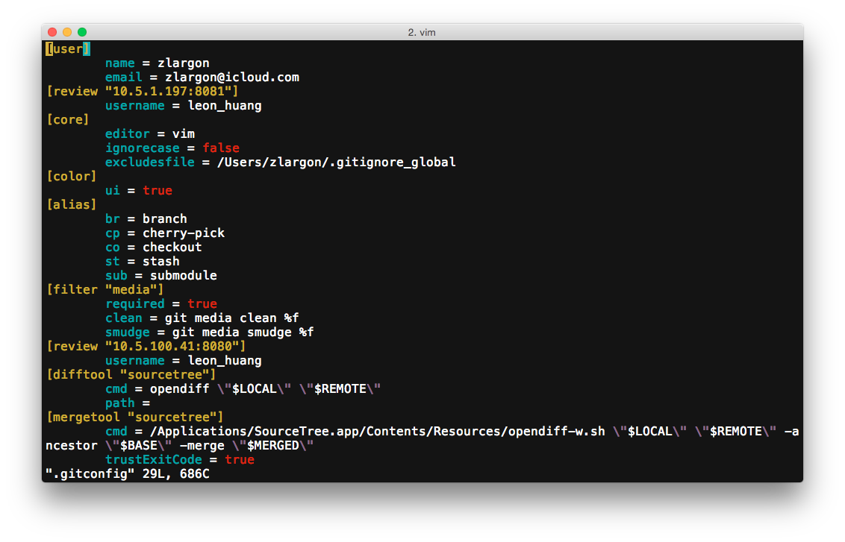
Git .gitconfig
Distributed VCS - Git

Slide 12

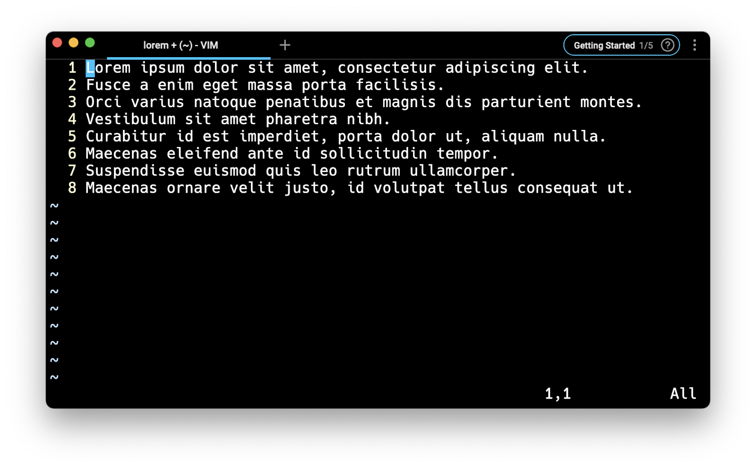
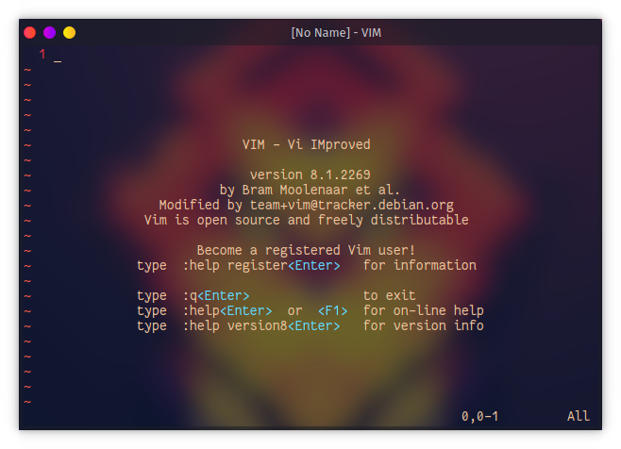
Vim

Slide 13
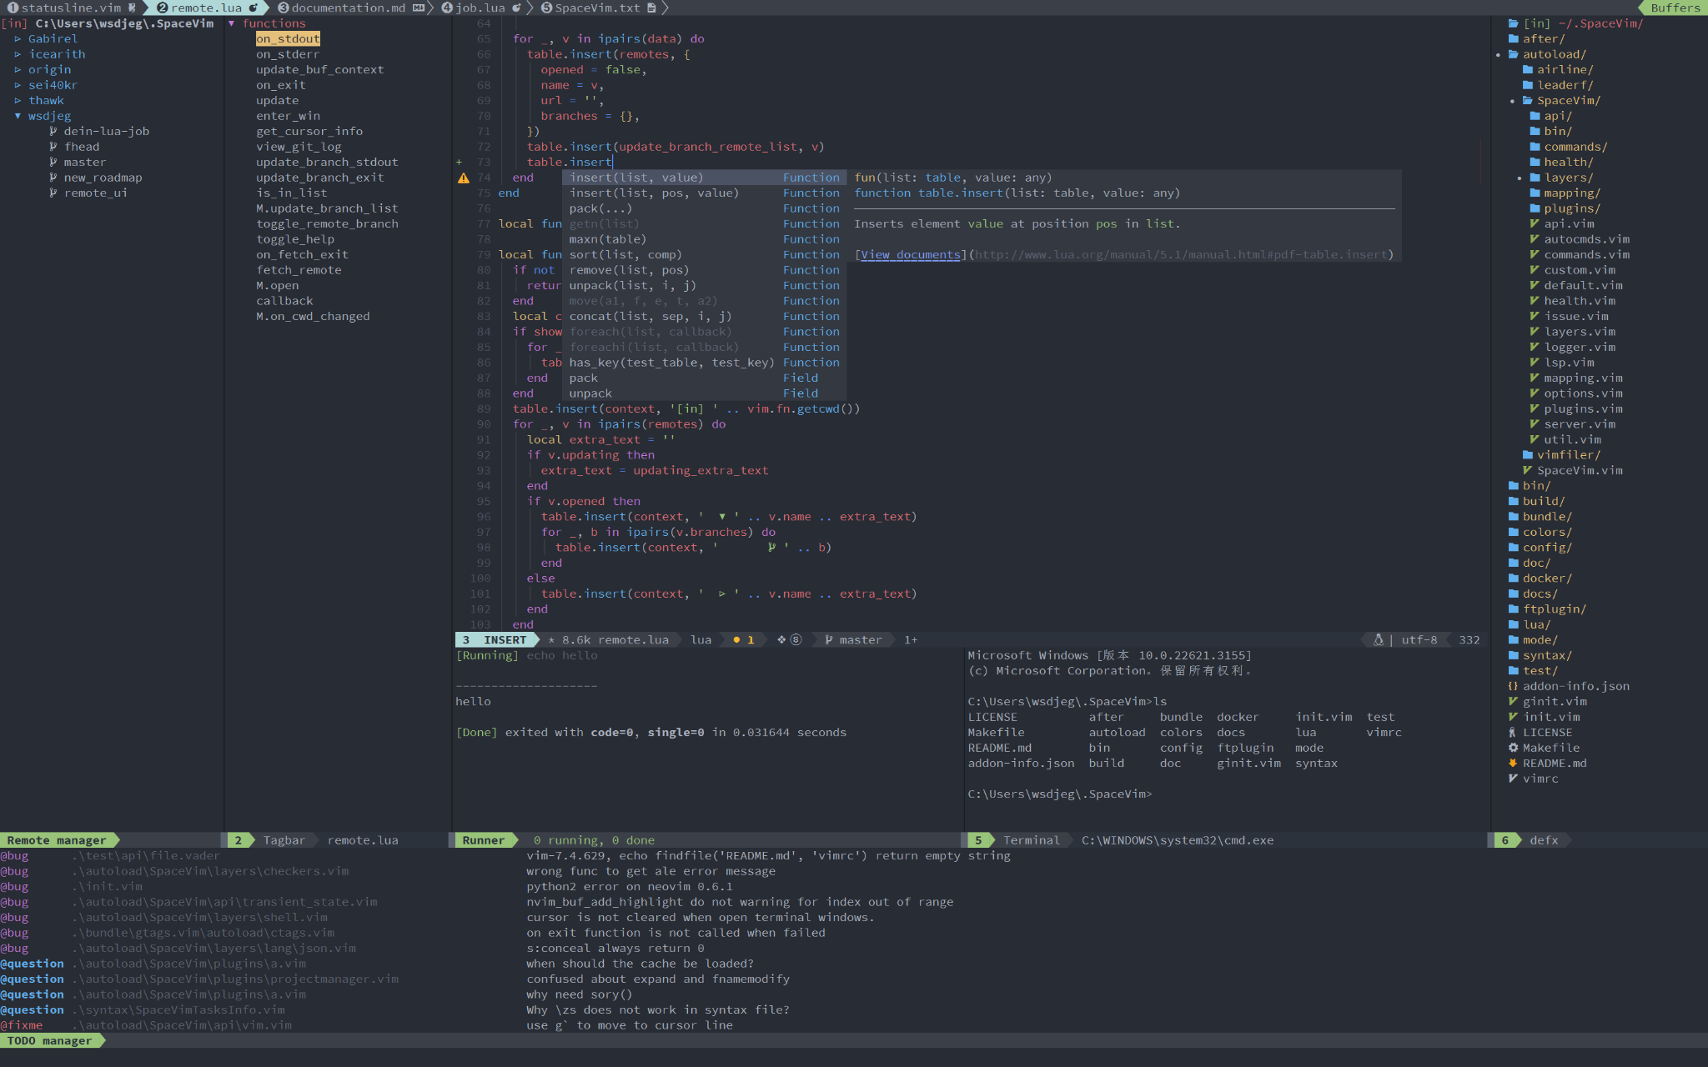
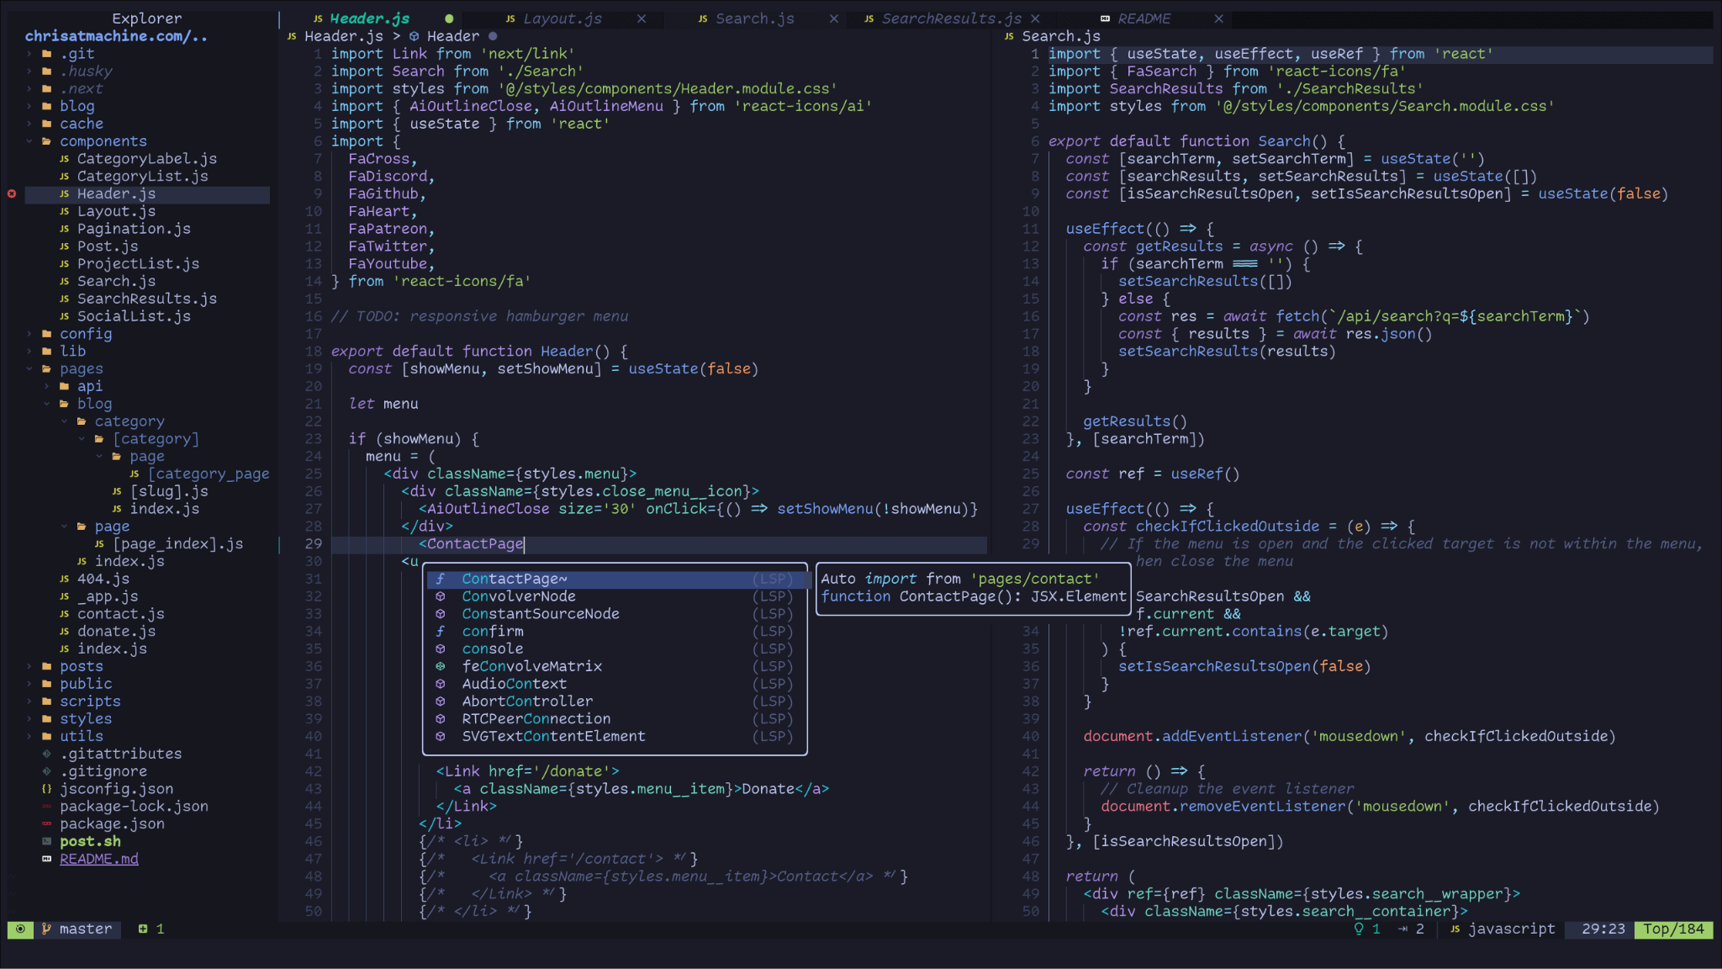
Vim

Slide 14

Vim
ThePrimeagen

Slide 15
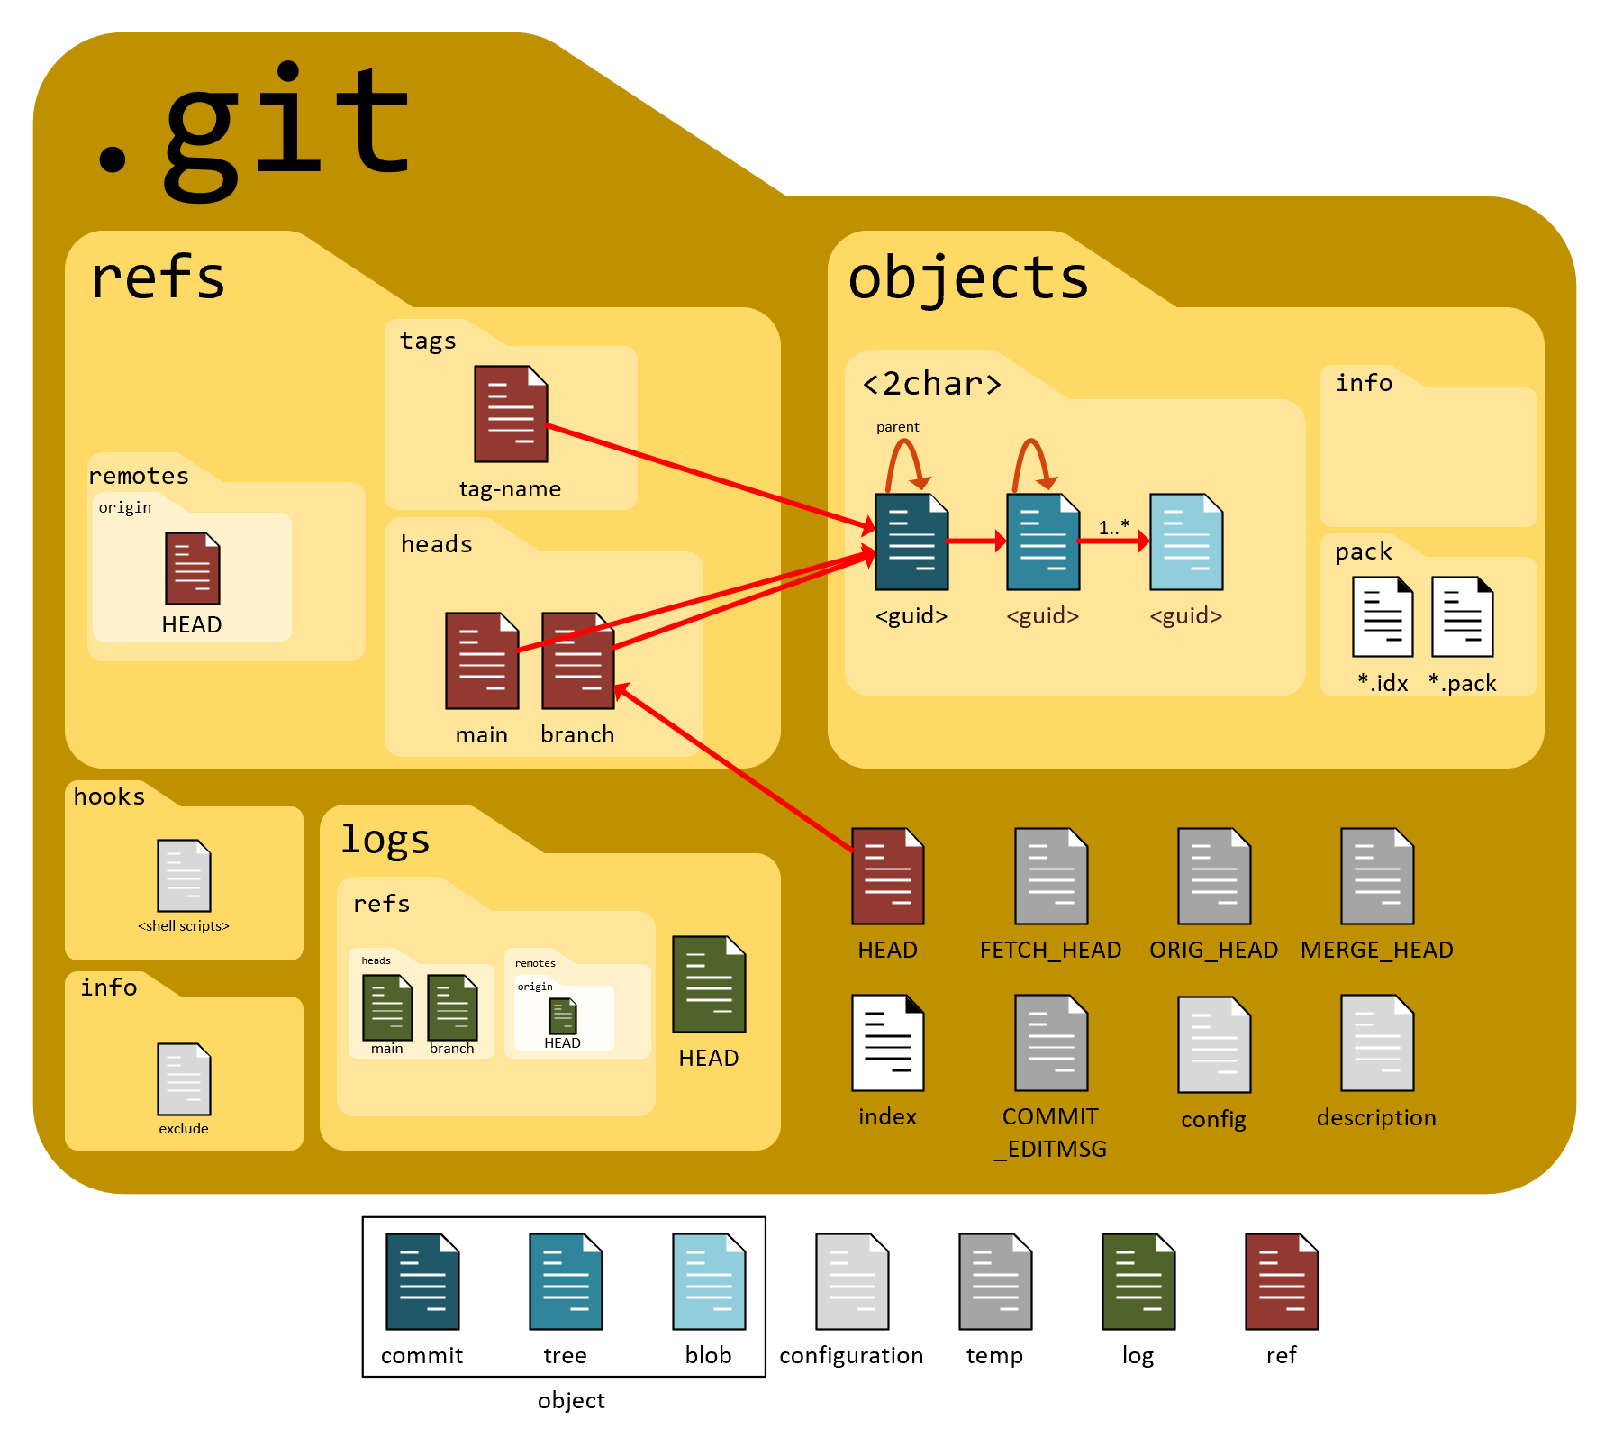
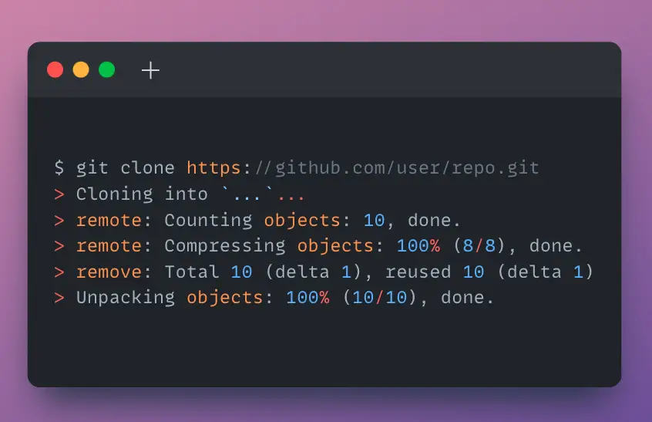
Git init
Distributed VCS - Git
$ git init
$ git clone <repo>

Slide 16
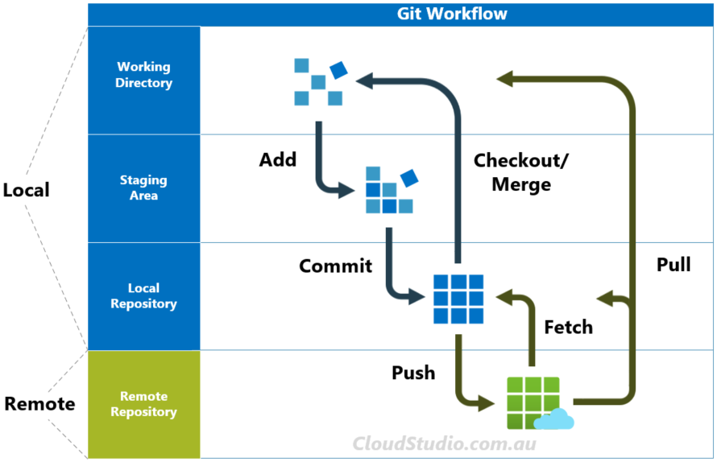
Git workflow
Distributed VCS - Git
$ git add <file>
$ git commit
$ git push
$ git pull

Slide 17
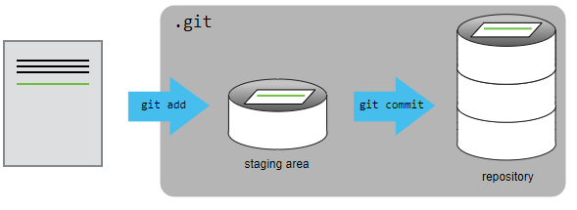
Git staging area
Distributed VCS - Git

Slide 18
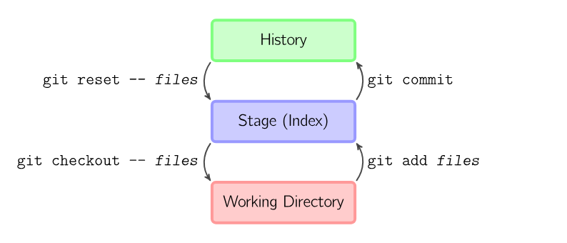
Git basics
Distributed VCS - Git

Slide 19

Git commit
Distributed VCS - Git

Slide 20
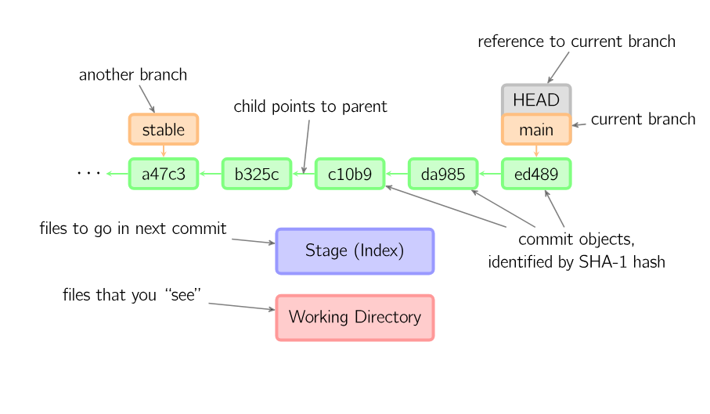
Git basics
Distributed VCS - Git

Slide 21
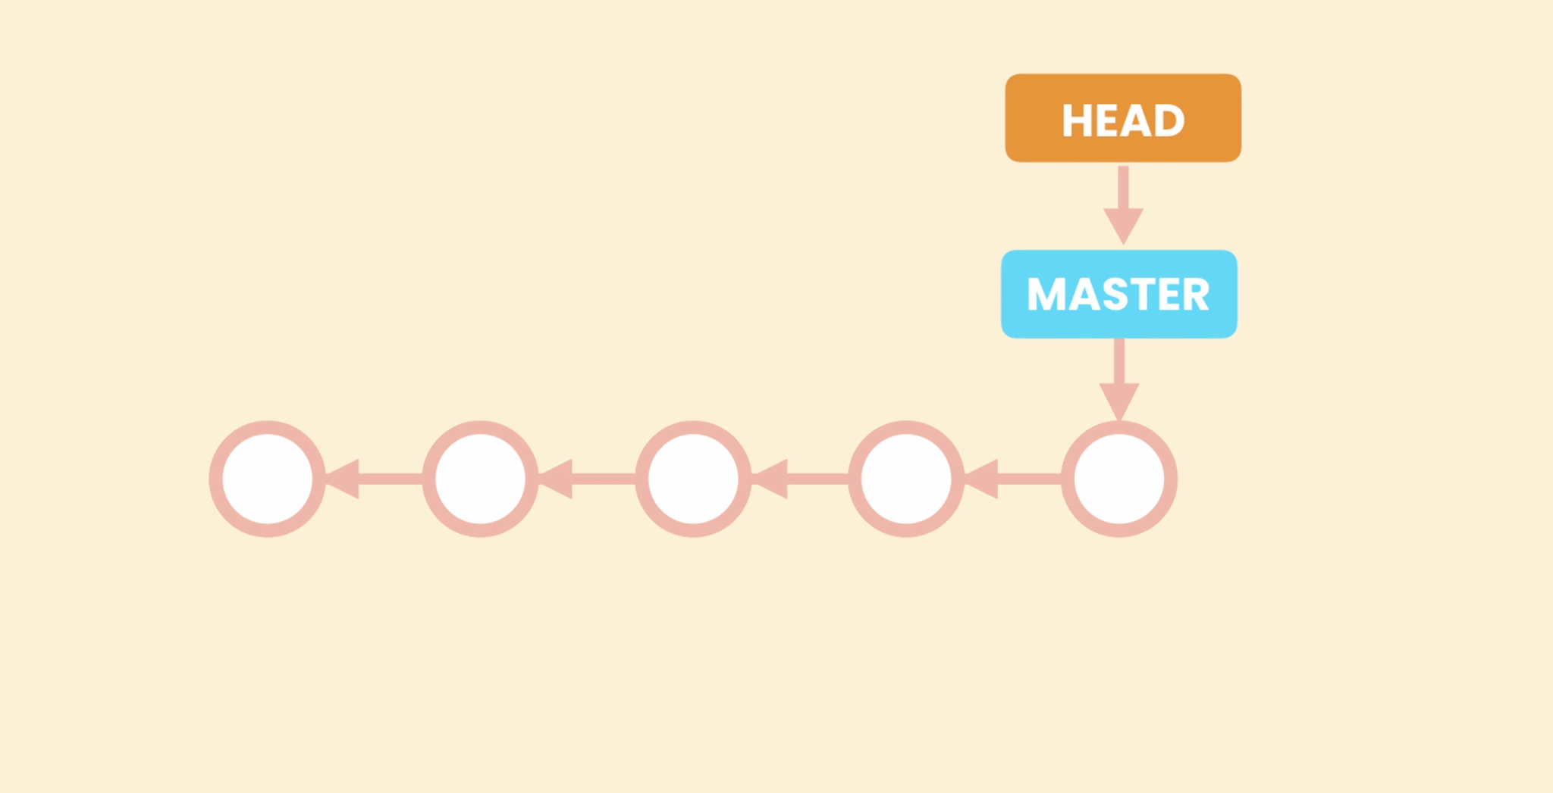
Git HEAD
Distributed VCS - Git

Slide 22
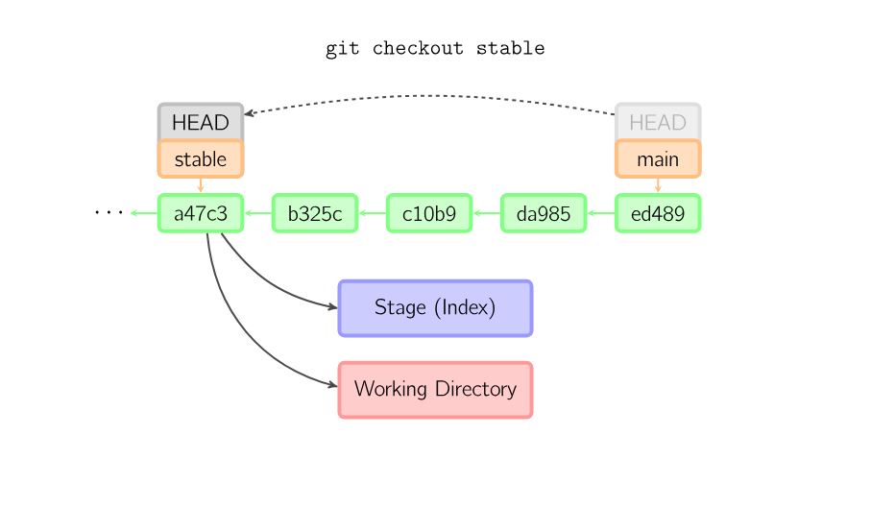
Git basics
Distributed VCS - Git

Slide 23
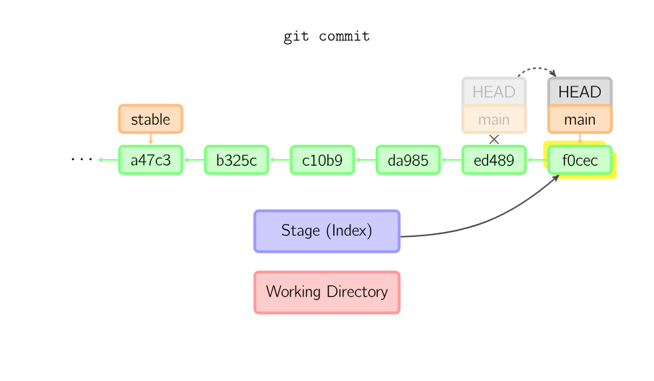
Git basics
Distributed VCS - Git

Slide 24
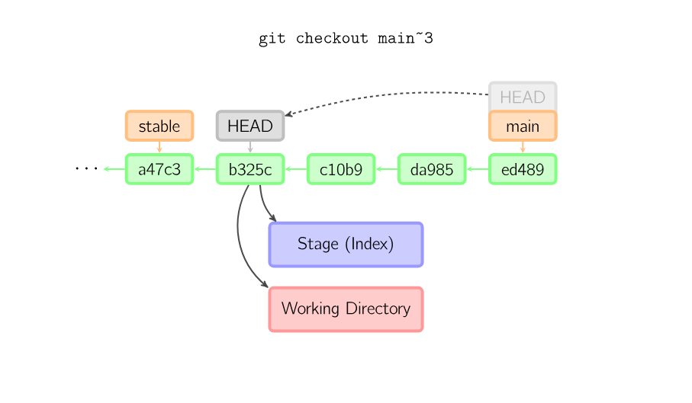
Git basics
Distributed VCS - Git

Slide 25
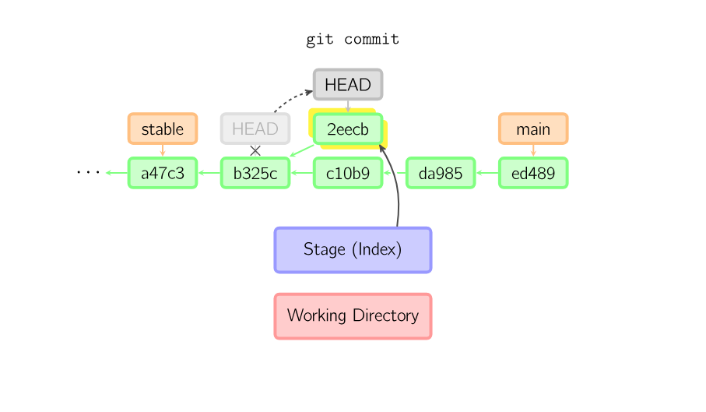
Git basics
Distributed VCS - Git

Slide 26
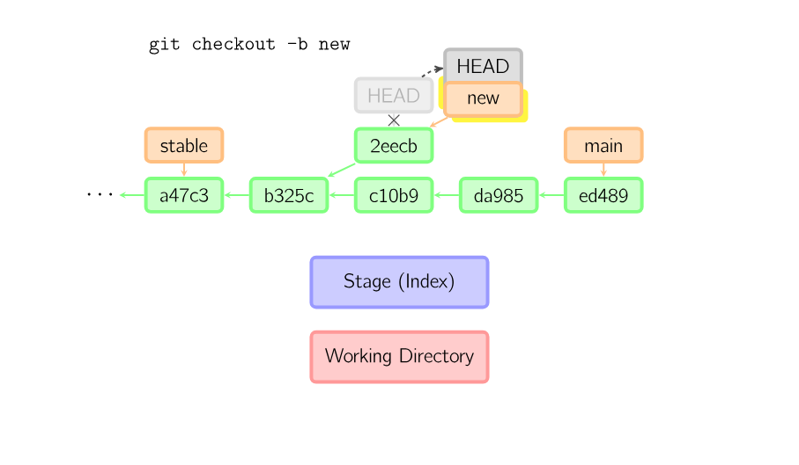
Git basics
Distributed VCS - Git

Slide 27
Git basics
Distributed VCS - Git

Slide 28
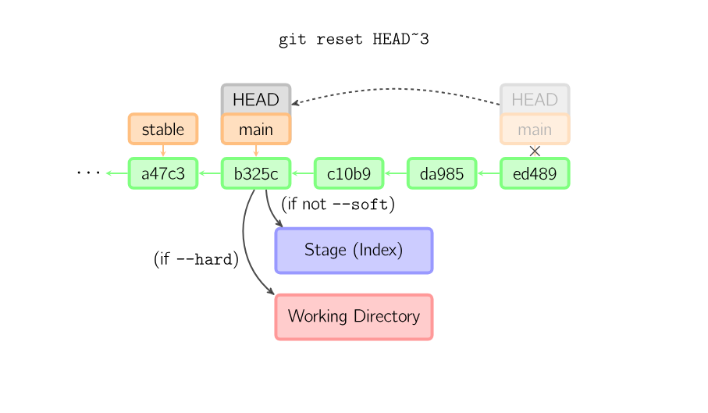
Git basics
Distributed VCS - Git

Slide 29
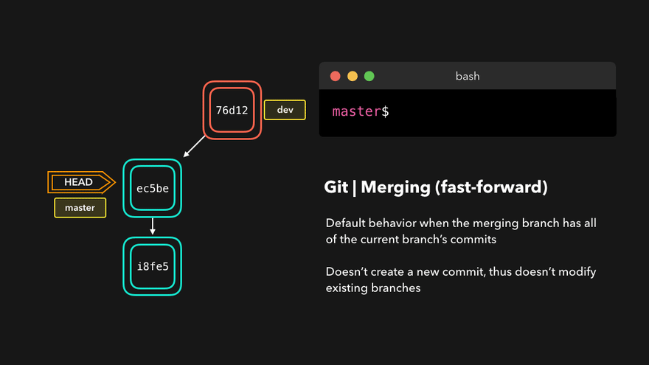
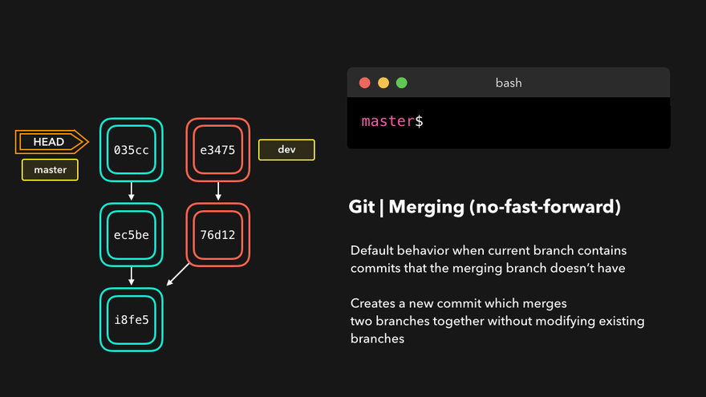
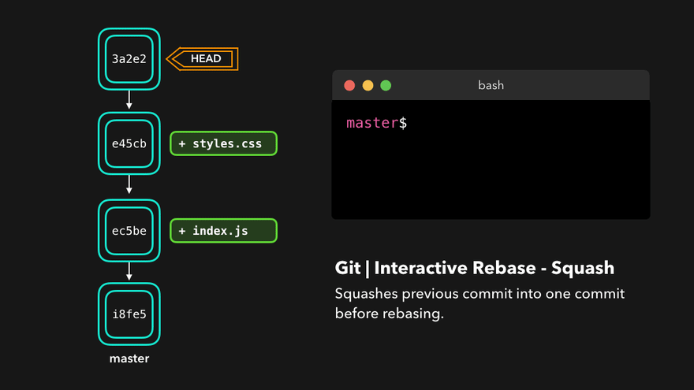
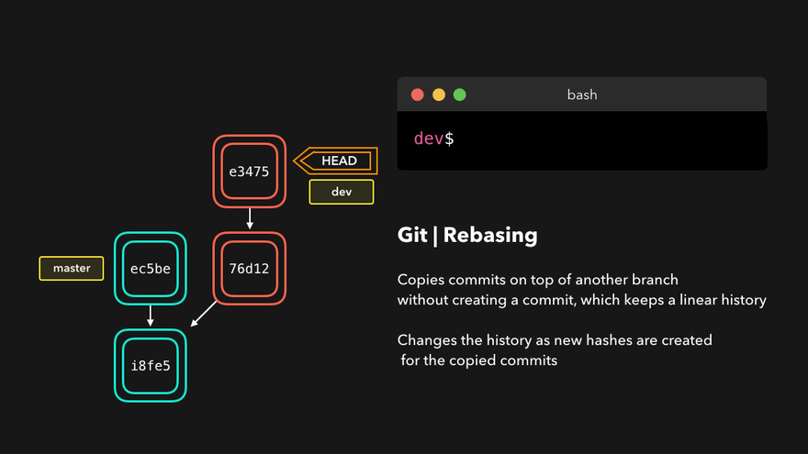
Git merge types
Fast-Forward Merge
Three-Way Merge
Squash Merge
Rebase Merge
Distributed VCS - Git
01
02
Simple updates without conflicts
Merging branches with conflicting changes
03
04
Maintains a clean commit history
Creates a linear project history

Slide 30
Fast-Forward Merge
Git merge types

Slide 31
Three-Way Merge
Git merge types

Slide 32
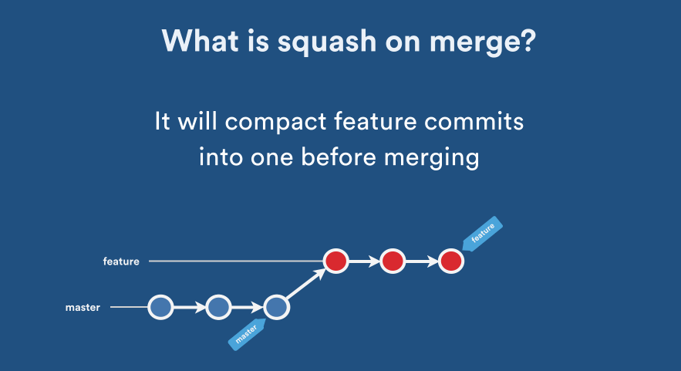
Squash Merge
Git merge types

Slide 33
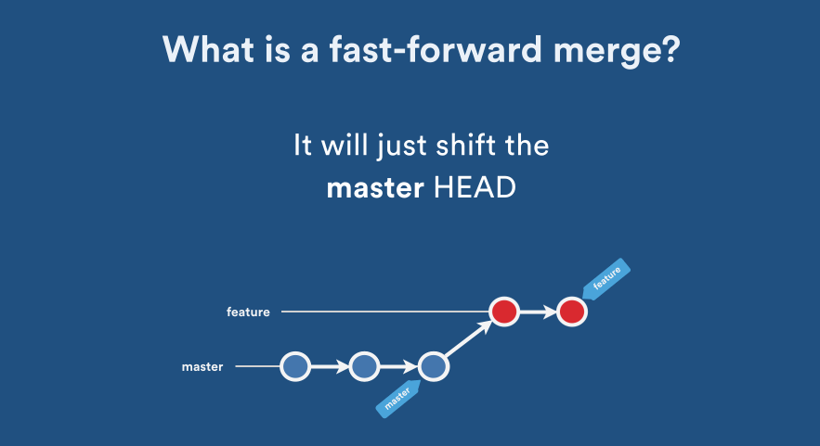
Fast-Forward Merge
Git merge types

Slide 34
Squash
Git merge types

Slide 35
Rebase Merge
Git merge types

Slide 36
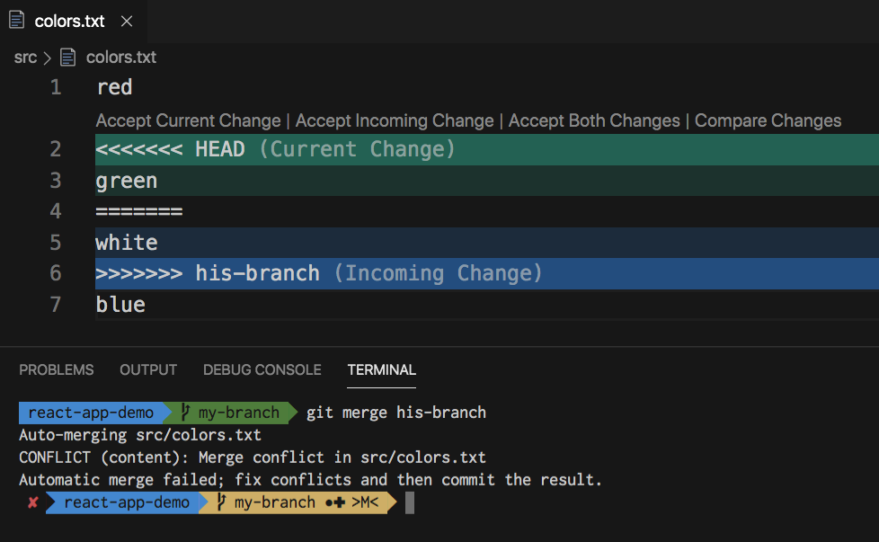
Merge conflicts
Distributed VCS - Git
$ git merge ––abort
$ git merge ––continue
$ git rebase ––abort
$ git rebase ––continue

Slide 37
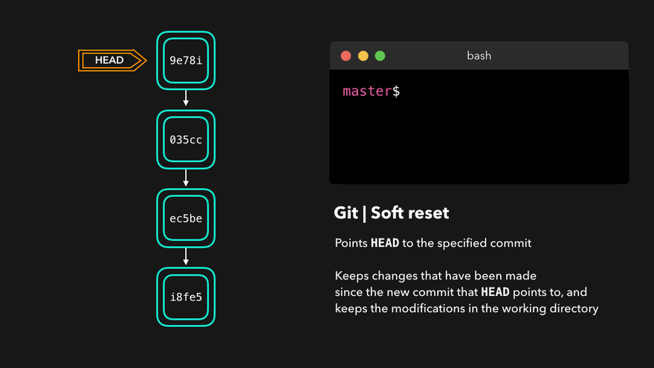
Git reset
Distributed VCS - Git

Slide 38
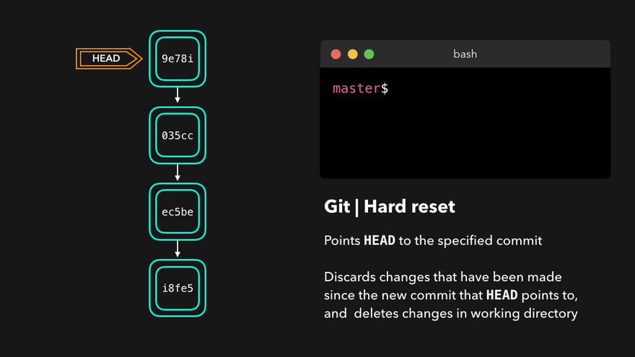
Git reset
Distributed VCS - Git

Slide 39
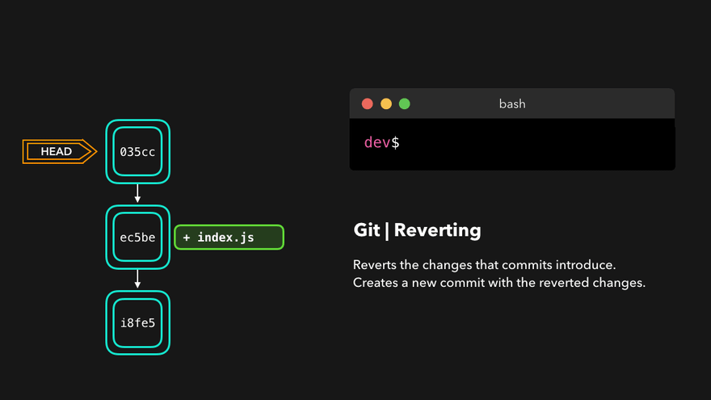
Git revert
Distributed VCS - Git

Slide 40
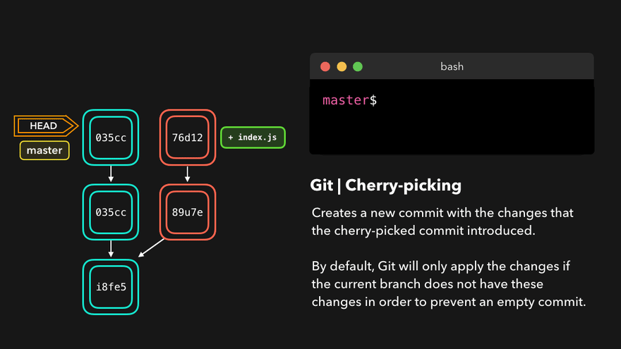
Git cherry-picking
Distributed VCS - Git

Slide 41
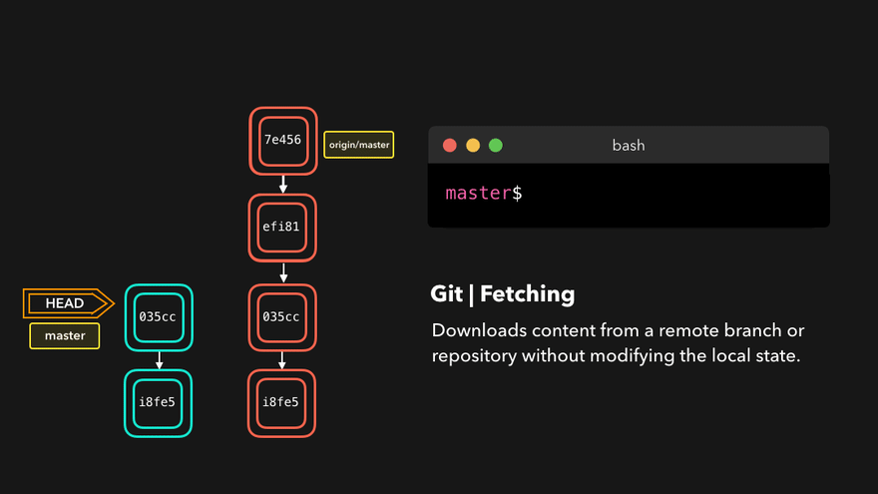
Git fetch
Distributed VCS - Git

Slide 42
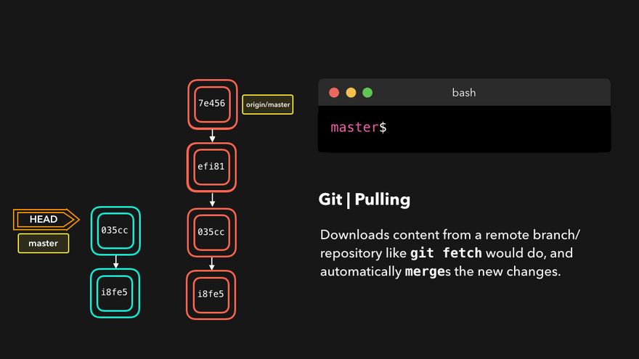
Git pull
Distributed VCS - Git

Slide 43
Git pull
Distributed VCS - Git
$ git pull
=
$ git fetch && git merge
$ git pull ––rebase ––autostash

Slide 44
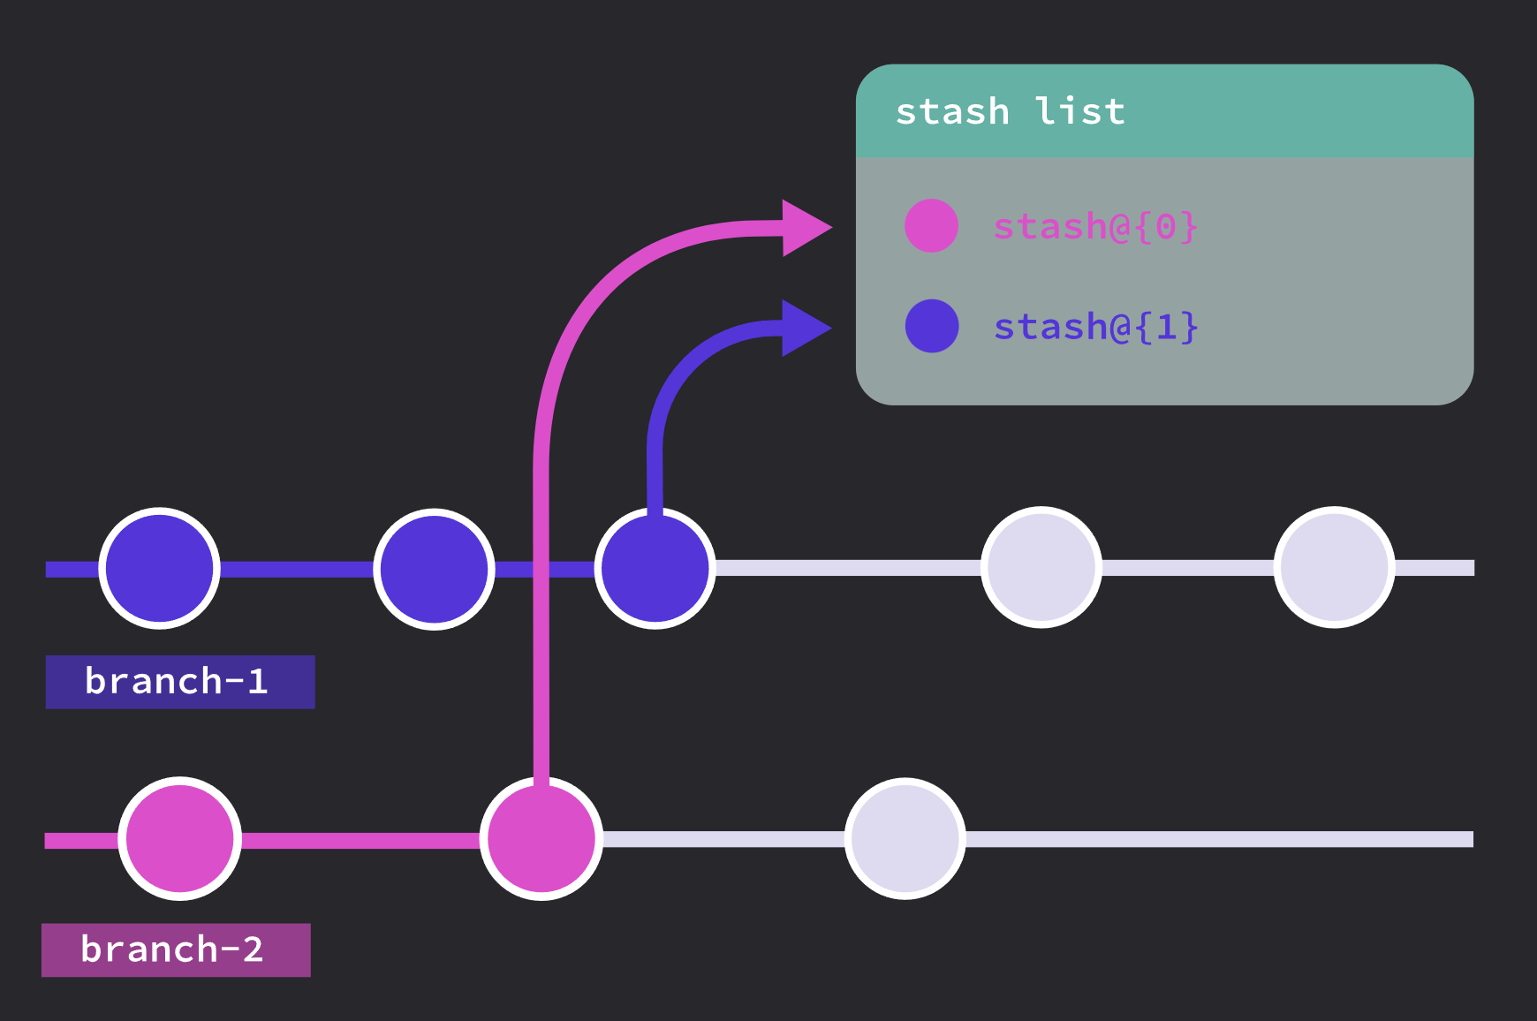
Git stash
Distributed VCS - Git
$ git stash “unfinished feature”
$ git stash apply
$ git stash pop
$ git stash drop
$ git stash list

Slide 45
Git reflog
Distributed VCS - Git

Slide 46
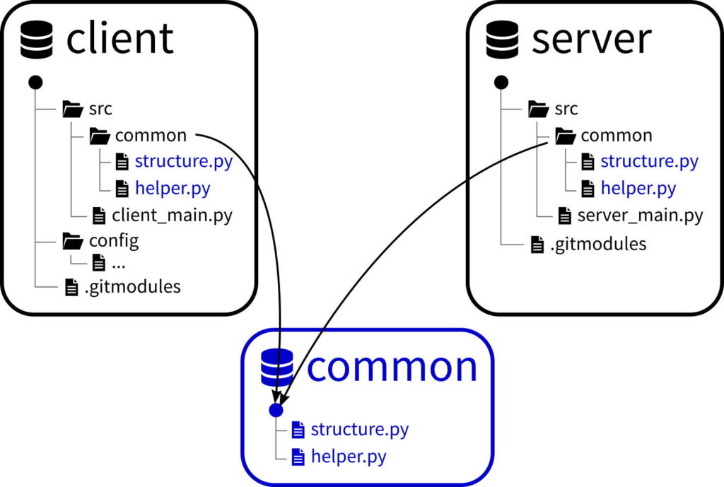
Git submodule
Distributed VCS - Git

Slide 47
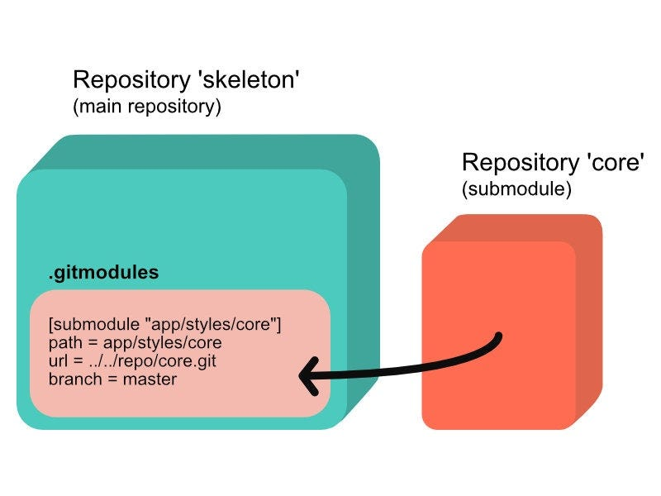
Git submodule
Distributed VCS - Git
$ git submodule add <repo-url> <path-to-submodule>
> [submodule "<path-to-submodule>"]
path = <path-to-submodule>
url = <repo-url>
branch = main
$ git submodule update --remote

Slide 48
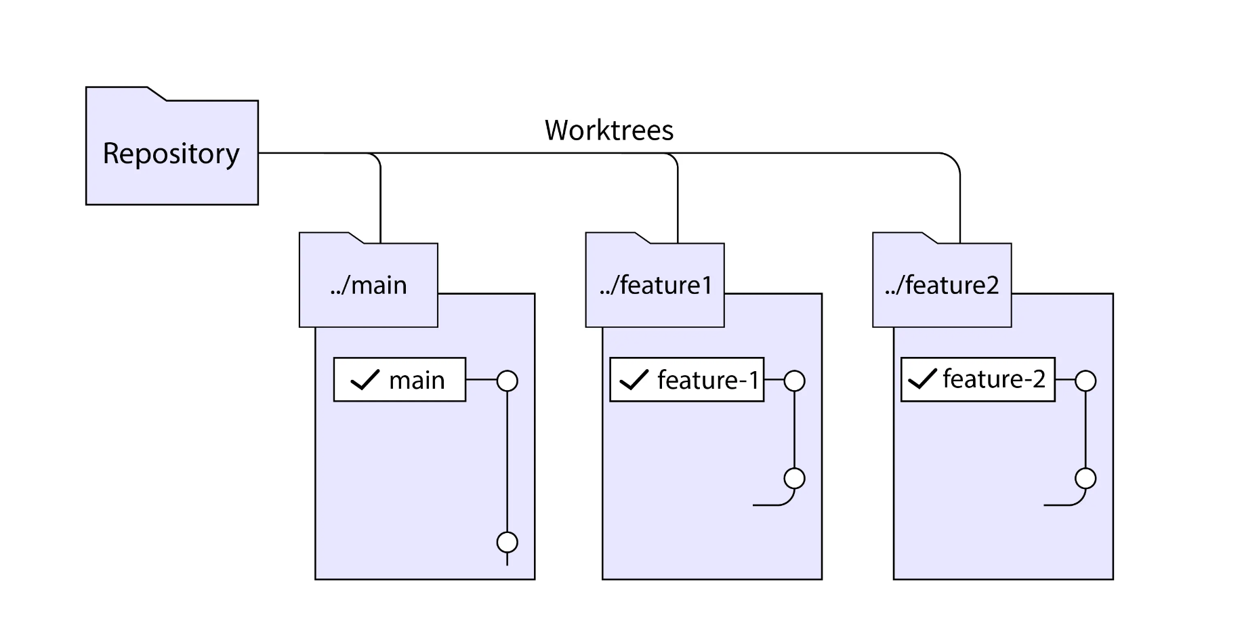
Git worktree
Distributed VCS - Git

Slide 49
Git worktree
Distributed VCS - Git
$ git worktree add ../feature1 <BRANCH_NAME>
$ cd ../feature1
$ git worktree list

Slide 50
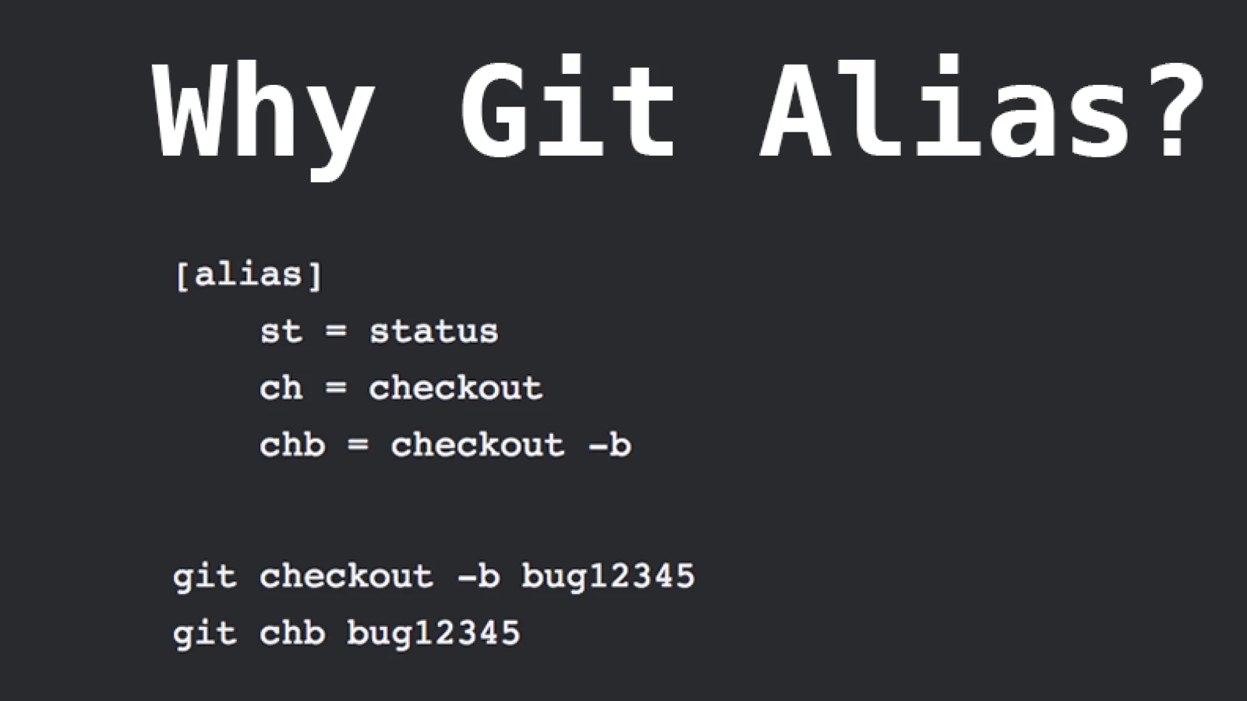
Git automation
Distributed VCS - Git
$ git config --global alias.updatesub "submodule update --remote"
$ git updatesub
$ git config --edit

Slide 51

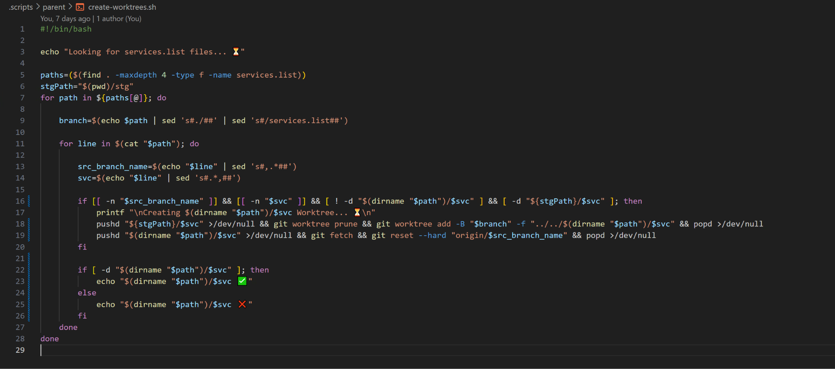
Bash

Slide 52
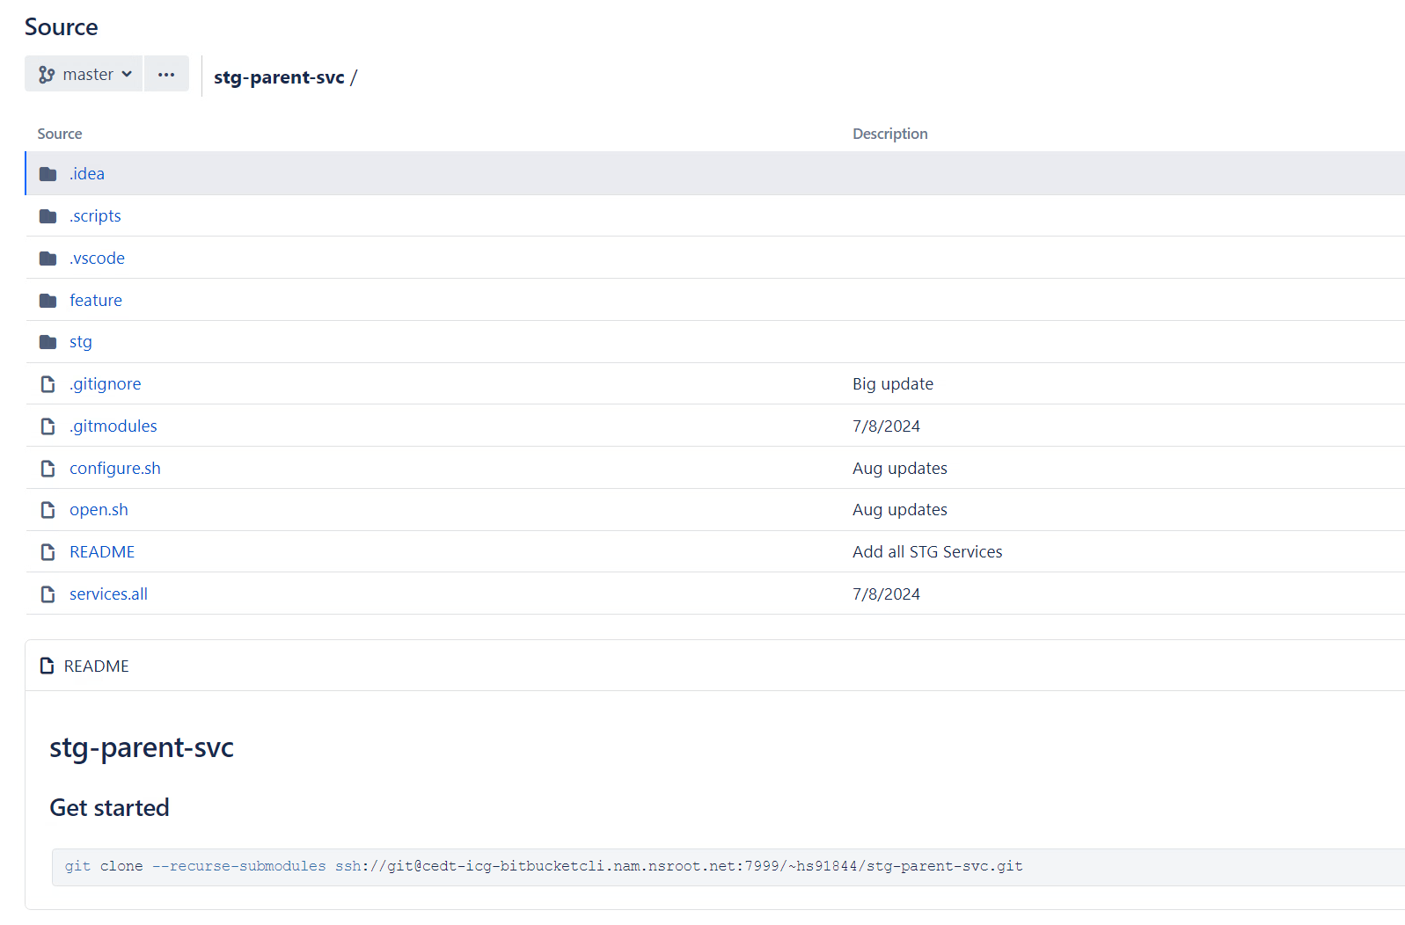
Git+Bash

Slide 53
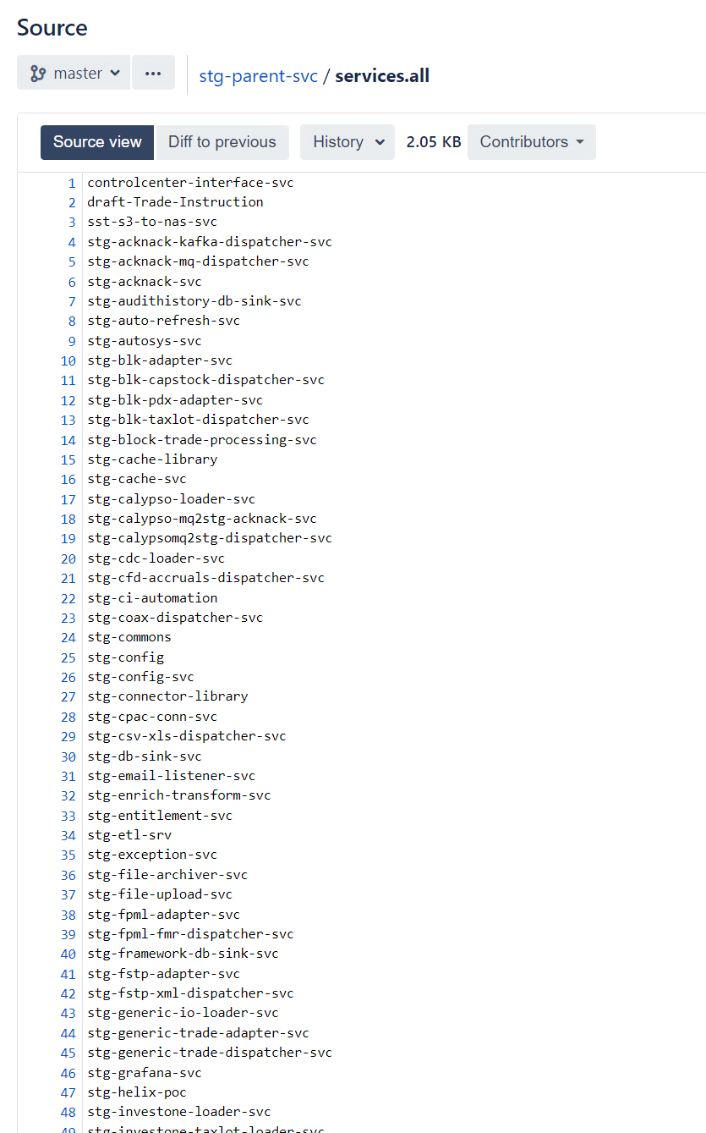
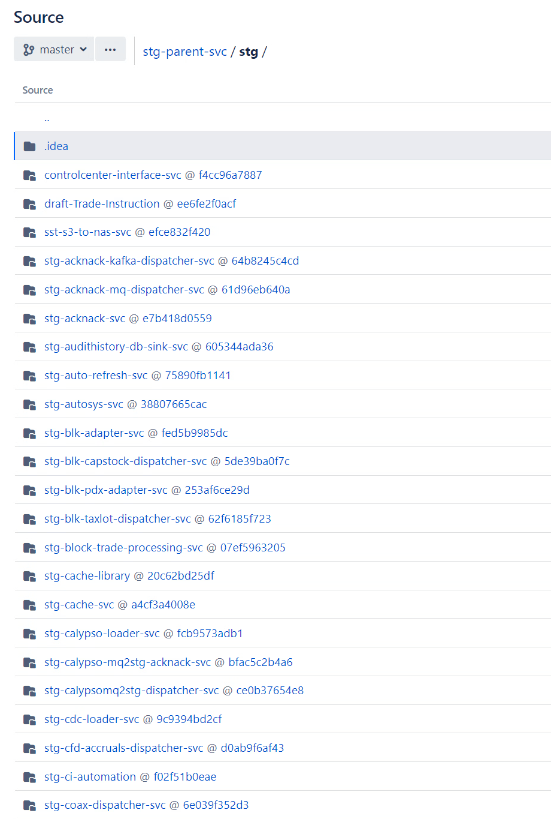
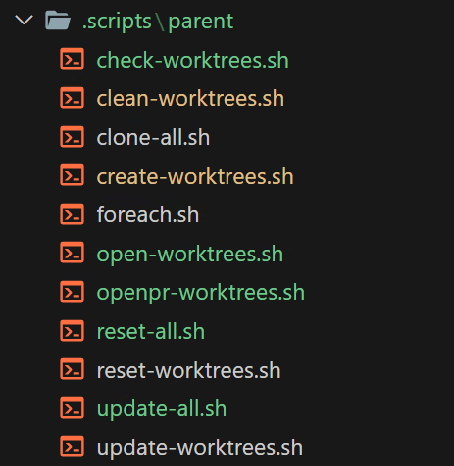
Git+Bash

Slide 54
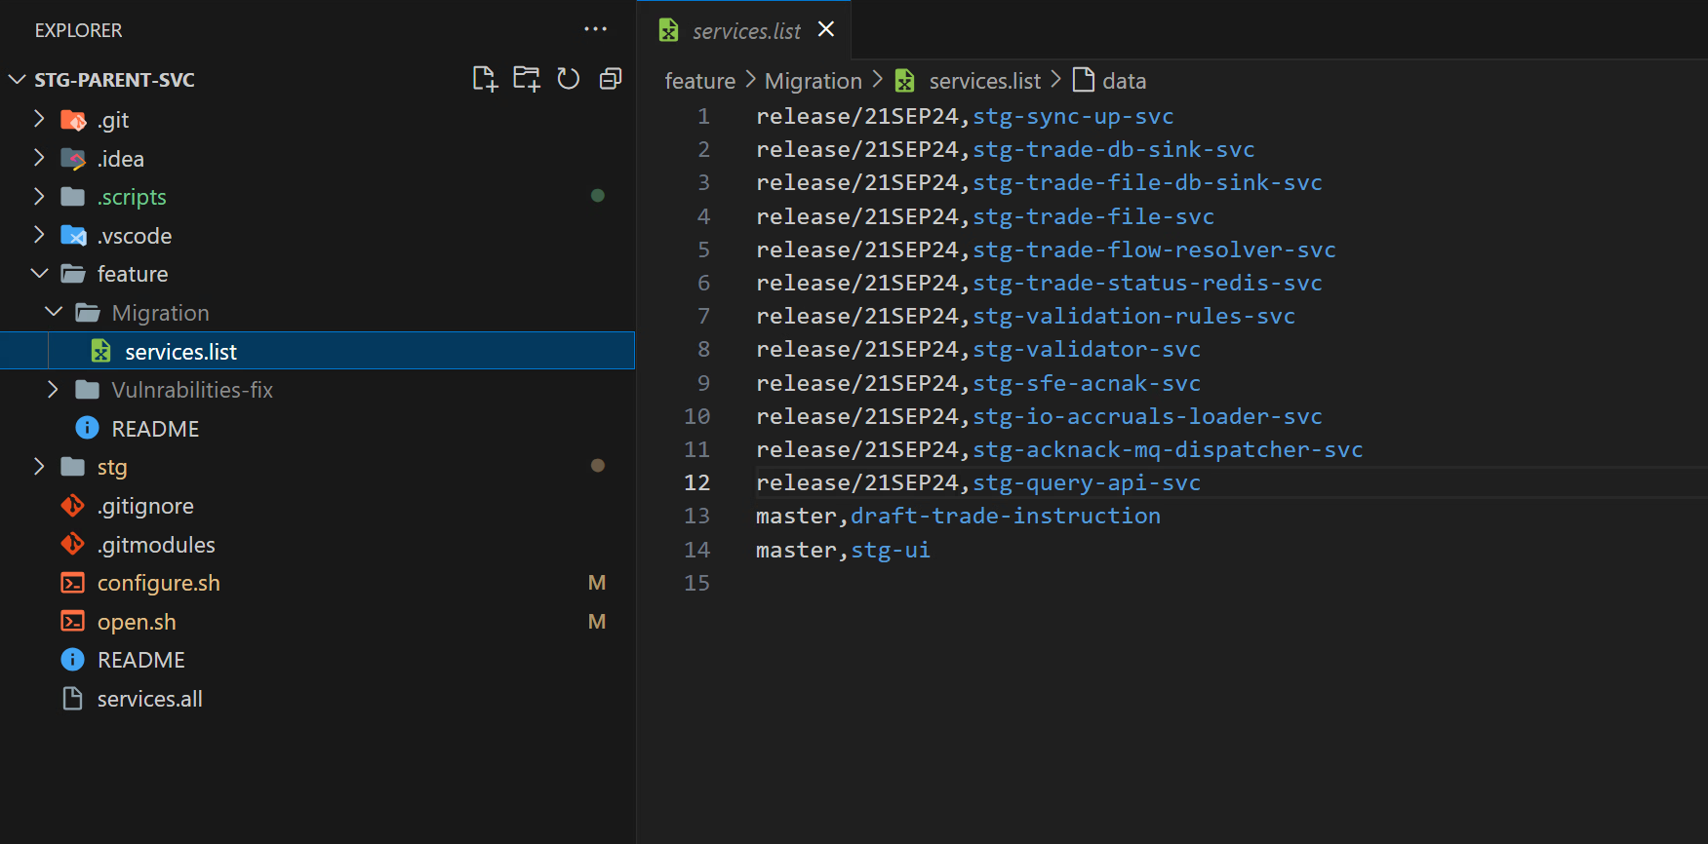
Git+Bash
$ git stg create worktrees

Slide 55
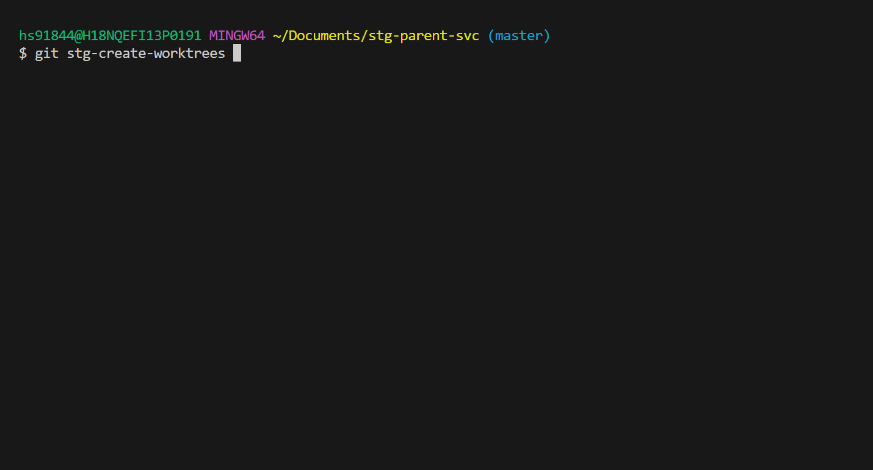
Git+Bash

Slide 56


Git+Bash

Slide 57

Git+Bash

Slide 58
by Hussain Sultan
citiBank
Thanks!
Do you have any questions?

